Slide 1
Context Free Grammar (CFG) and Languages(CFL)

Slide 2
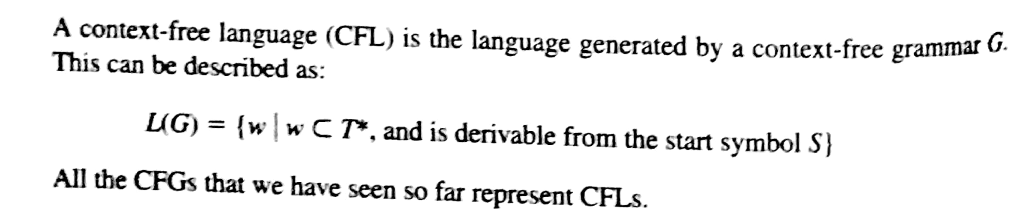
Context Free Language:
Definition: Let L be a language. Then L is a context-free language if and only if there exists a context-free grammar G such that L = L(G).

Slide 3
Context Free Language:
The class of context-free languages generalizes over the class of regular languages, i.e., every regular language is a context-free language.
The reverse of this is not true, i.e., every context-free language is not necessarily regular. For example, as we will see {0^{k}1^{k} | k≥0} is context-free but not regular.
Definition: Let G₁ and G₂ be context-free grammars. Then G1 and G2 are equivalent if and only if L(G₁) = L(G₂).

Slide 4
Context Free Grammar
Informally, a CFG consists of:
A set of replacement rules, each having a Left-Hand Side (LHS) and a Right-Hand Side (RHS).
Two types of symbols; variables /Non Terminals and terminals.
LHS of each rule is a single variable (no terminals).
RHS of each rule is a string of zero or more variables and terminals.

Slide 5
Context Free Grammar
Formally, a Context-Free Grammar (CFG) is a 4-tuple:
G = (V, T, P, S)
V - A finite set of variables or non-terminals
T - A finite set of terminals (V and T do not intersect: do not use same symbols)
This is our ∑
P - A finite set of productions, each of the form A –> α, where A is in V and
α is in (V ∪ T)*
Note that α may be ε
S - A starting non-terminal (S is in V)

Slide 6
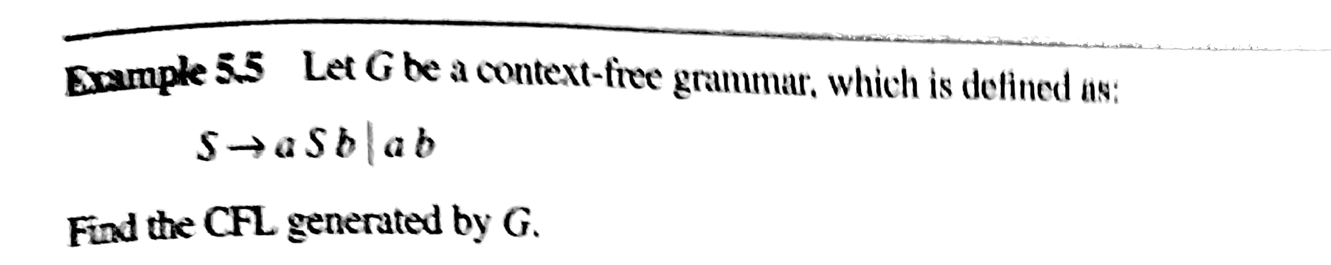


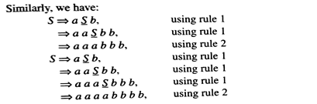
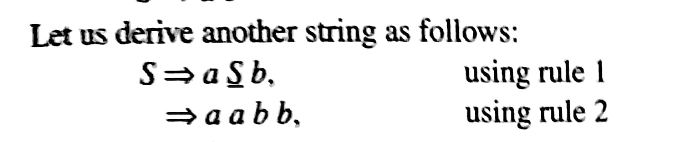
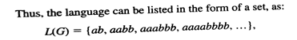


Slide 7
Describe the language generated by following CFG.
G = ({A, B, C, S}, {a, b, c}, P, S)
P:
(1) S –> ABC
(2) A –> aA
(3) A –> ε
(4) B –> bB
(5) B –> ε
(6) C –> cC
(7) C –> ε

Slide 8
Example CFG for ?:
G = ({A, B, C, S}, {a, b, c}, P, S)
P:
(1) S –> ABC
(2) A –> aA A –> aA | ε
(3) A –> ε
(4) B –> bB B –> bB | ε
(5) B –> ε
(6) C –> cC C –> cC | ε
(7) C –> ε
Example Derivations:
S => ABC (1) S => ABC (1)
=> BC (3) => aABC (2)
=> C (5) => aaABC (2)
=> ε (7) => aaBC (3)
=> aabBC (4)
=> aabC (5)
=> aabcC (6)
=> aabc (7)
Note that G generates the language a*b*c*

Slide 9
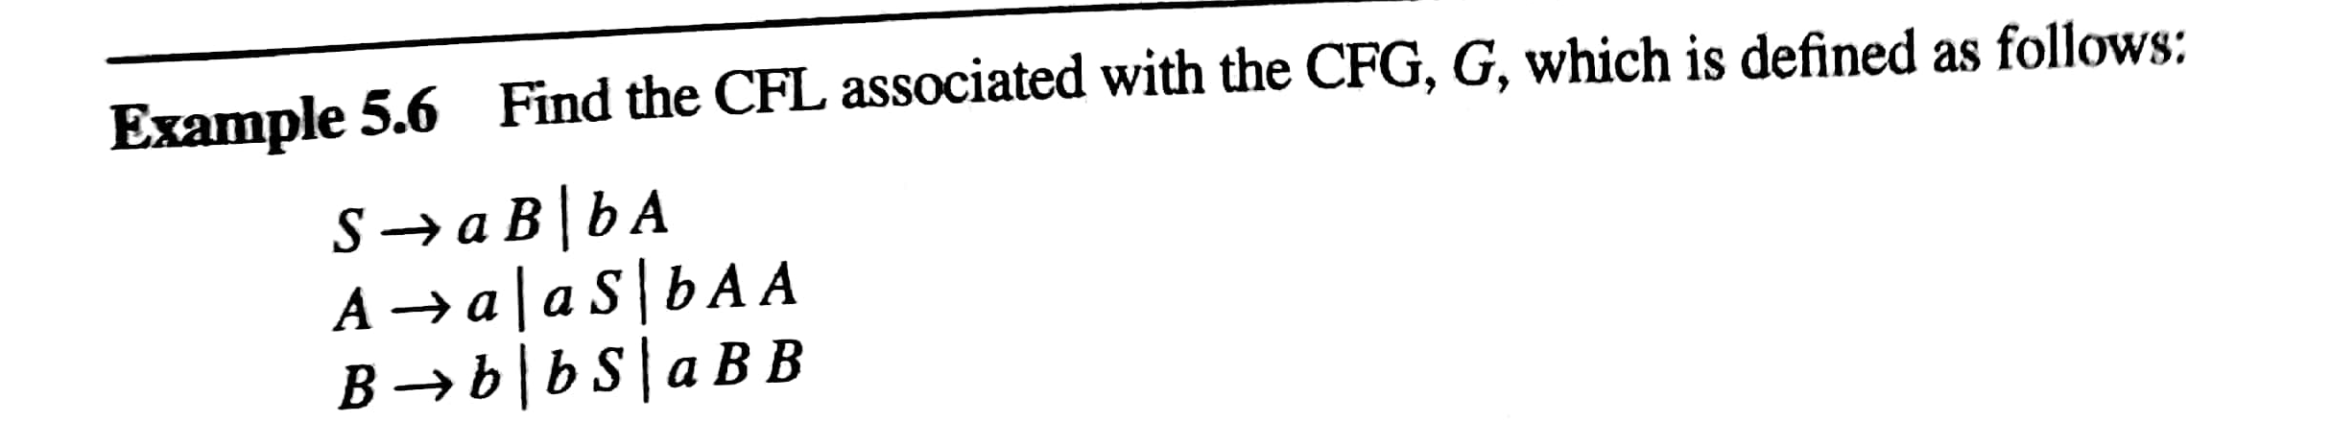

Slide 10
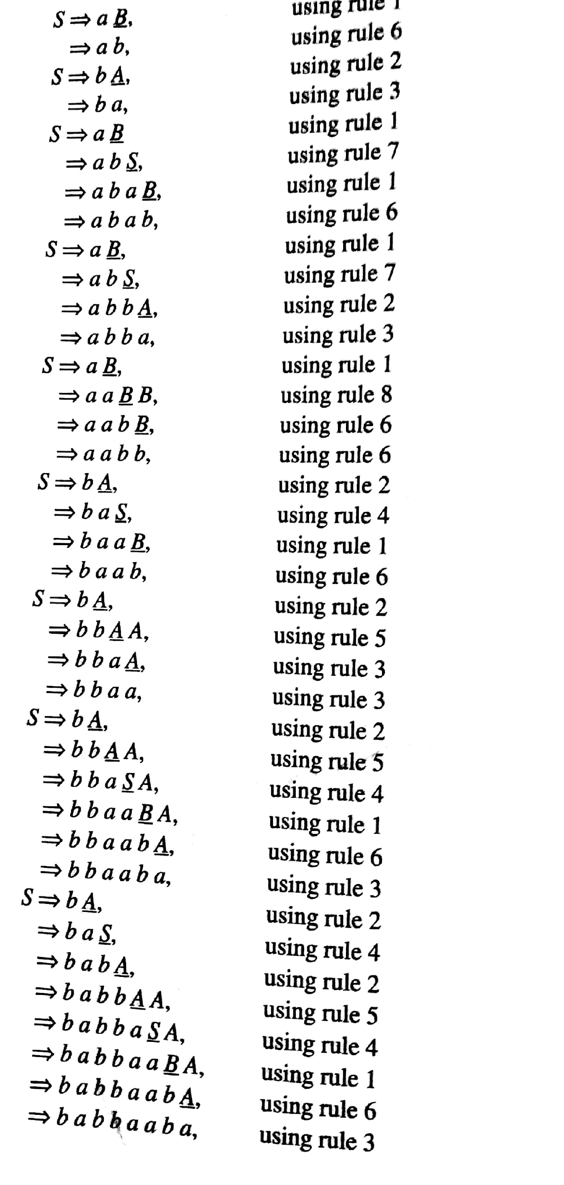
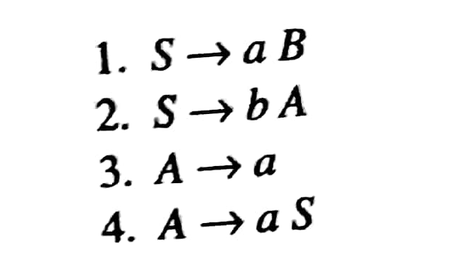
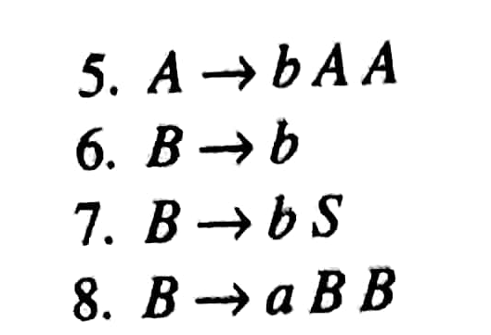

Slide 11
Write CFG For given Language

Slide 12
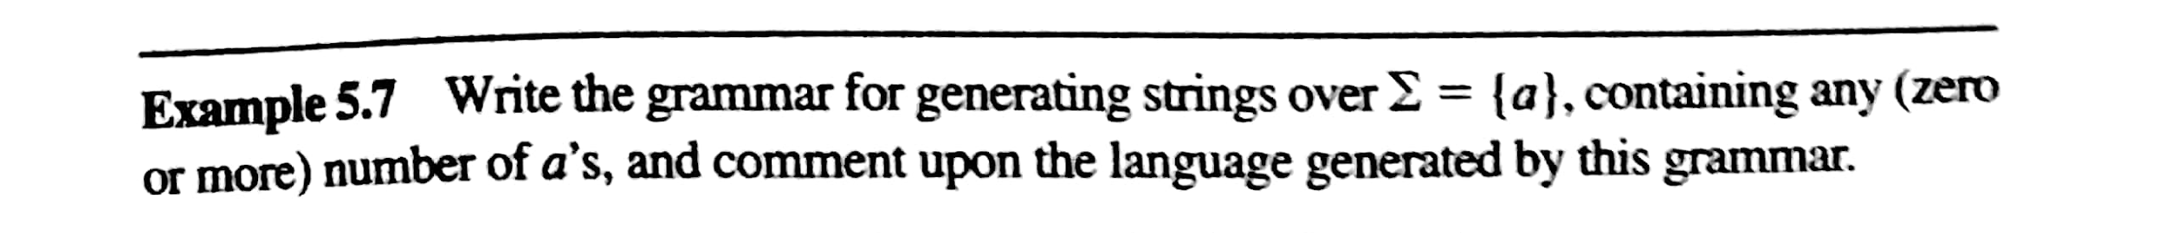


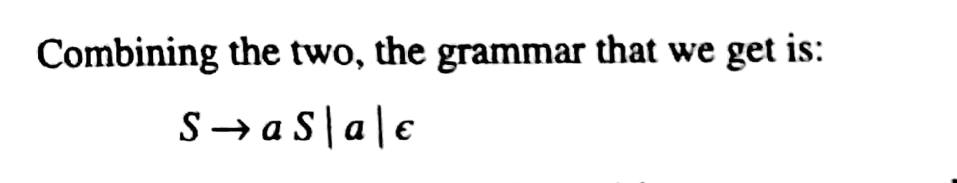
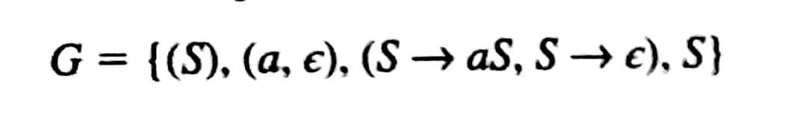

Slide 13
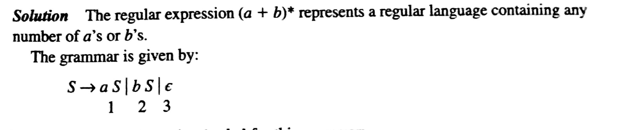
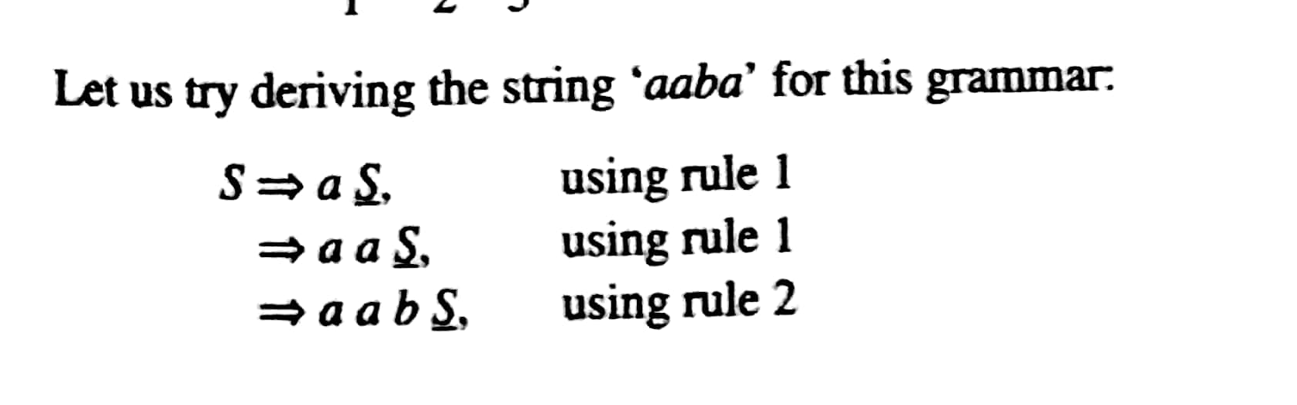

Slide 14
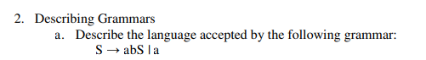
Exercises

Slide 15
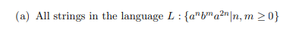
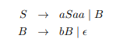

. Give a context-free grammar (CFG) for each of the following languages over the alphabet Σ = {a, b}:
Exercises

Slide 16

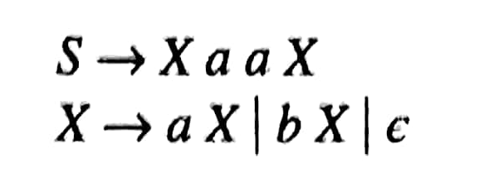
Example1 : Write CFG

Slide 17
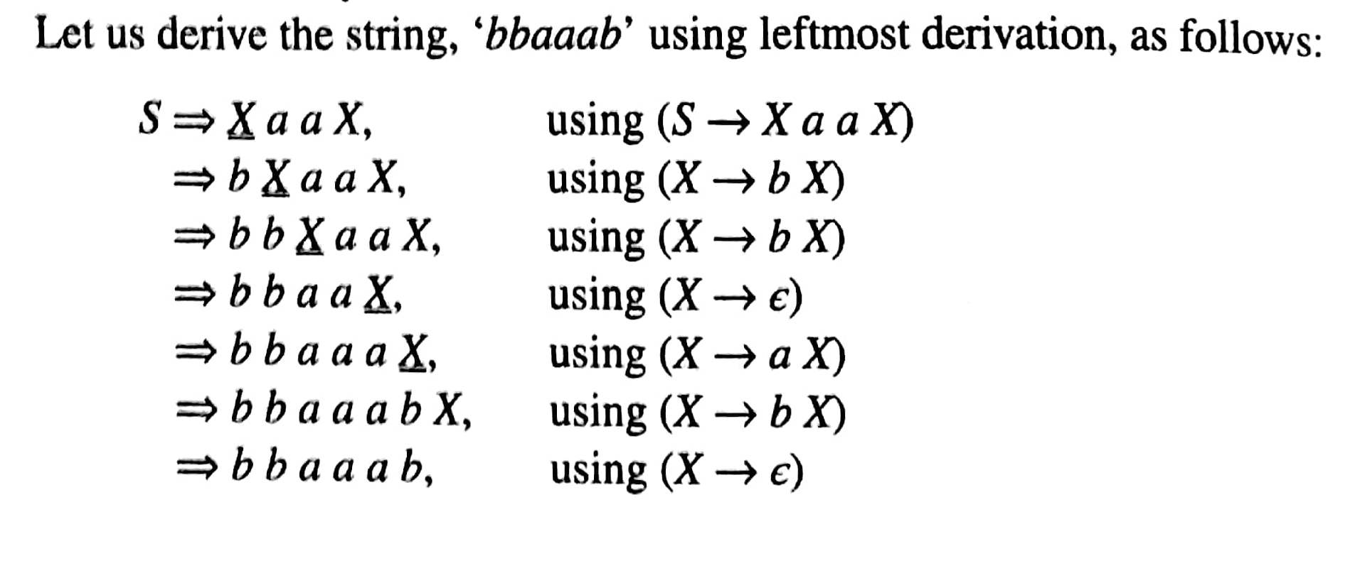

Slide 18
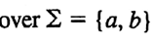

Example 2 : Write CFG
Write CFG containing substring “abb”
S🡪 XabbX
X🡪aX | bX |

Slide 19
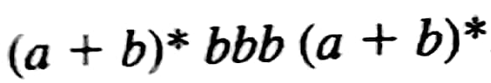

Write the grammar for the language represented by R.E.
Example 4 : Write CFG

Slide 20
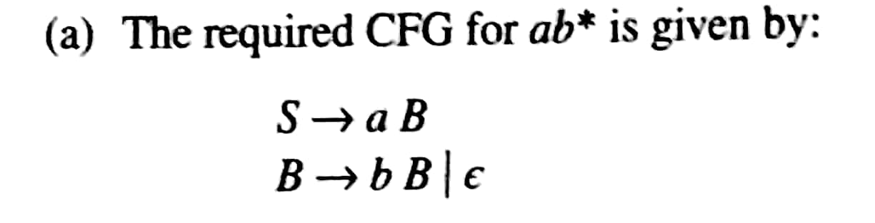
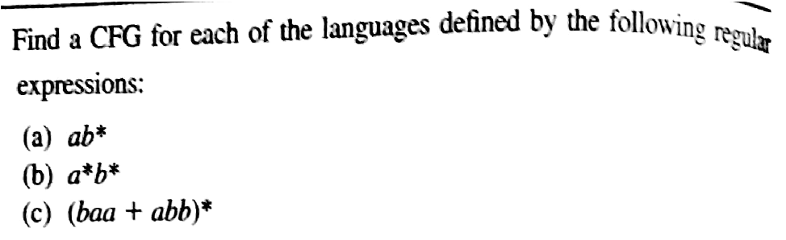
Example 5 : Write CFG

Slide 21
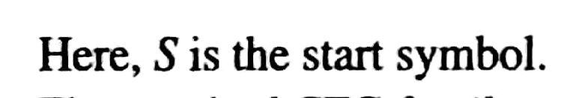
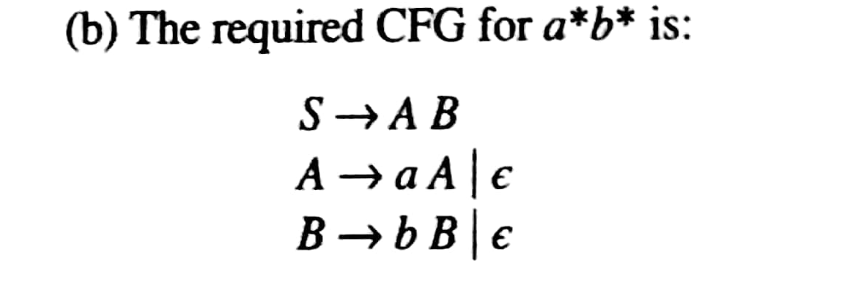
Solution

Slide 22
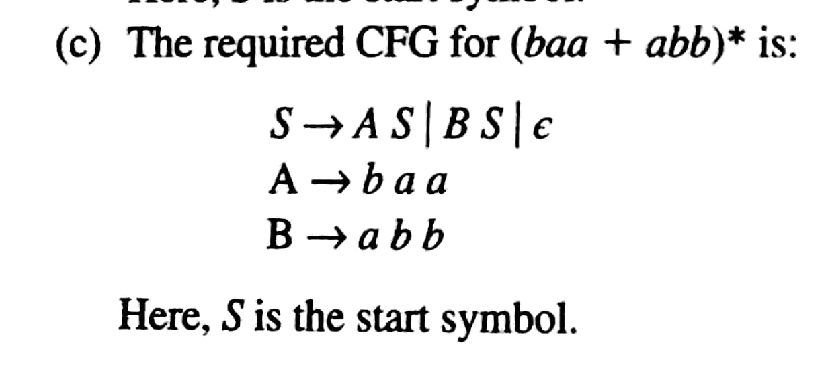
Solution

Slide 23
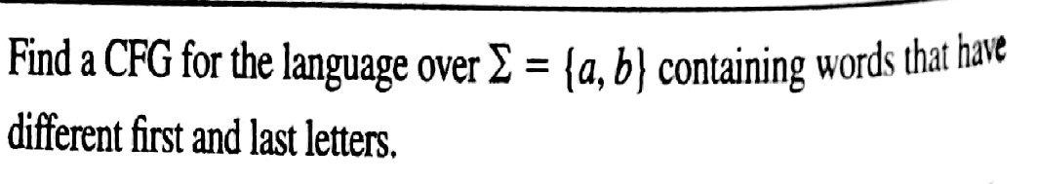
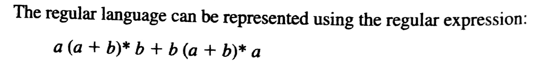
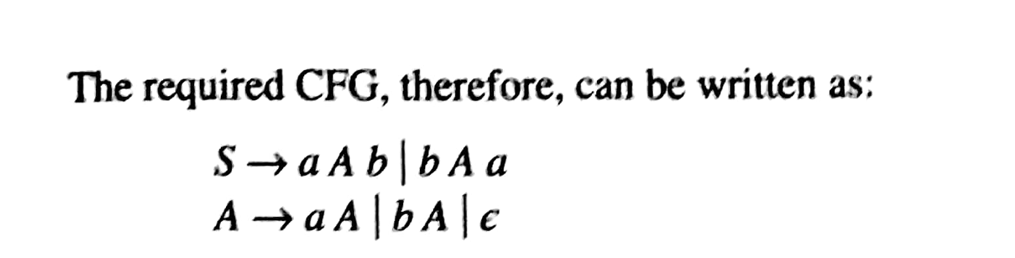

Slide 24
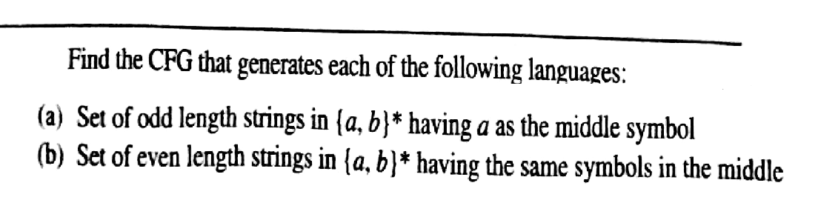

Slide 25
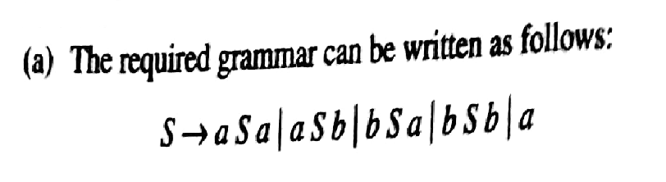

Slide 26
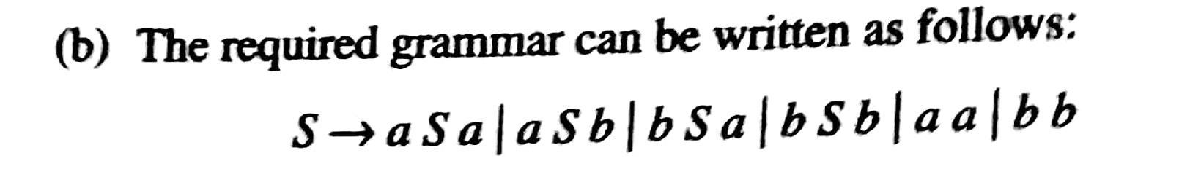

Slide 27
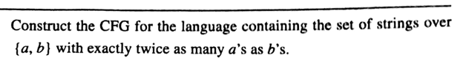
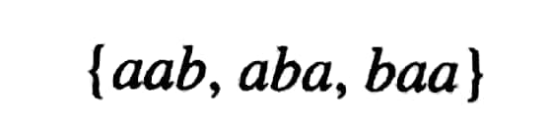
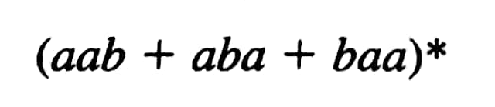
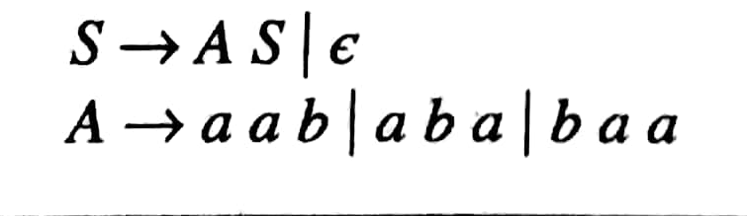
RE=

Slide 28
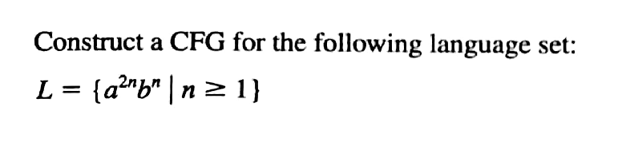
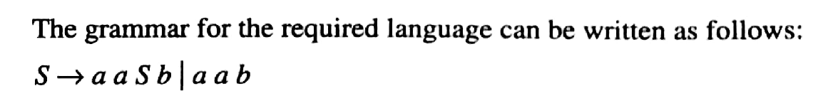

Slide 29
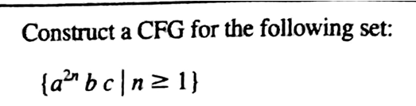
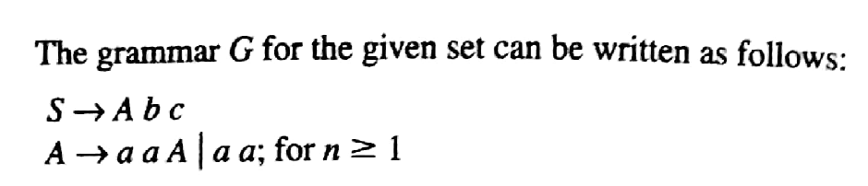

Slide 30
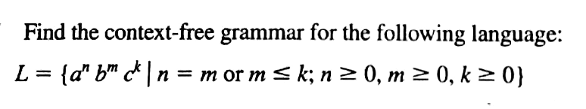
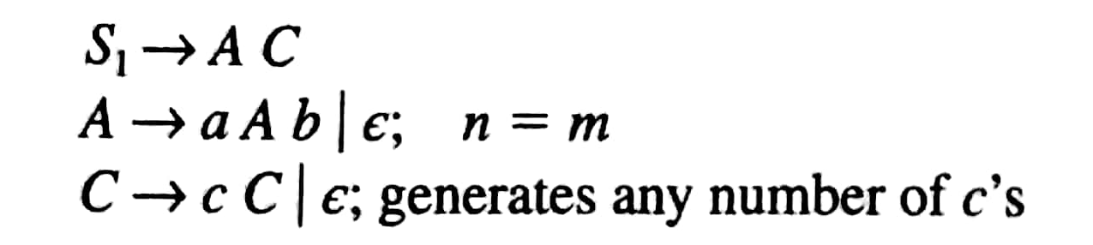

Slide 31


Example 3 : Write CFG

Slide 32
Write CFG for following languages:
L={ a^{i} b^{j} c^{k} | i=j+k, I,j,k ≥ 0}
L={ a^{m+n} b^{m} c^{n} | n,m ≥ 0}
L={ 0^{m} 1^{n} 0^{m+n} | n,m ≥ 0}
L={ a^{n} b^{m} a^{n} | n ≥ 0, m ≥ 1 }
L={ a^{n} b^{n} c^{m} d^{m} | n,m ≥ 1} U {a^{m} b^{n} c^{n} d^{m} | n,m ≥ 1}

Slide 33
